Slide 1

IMPORTANCE OF ENVIRONMENTAL MANAGEMENT SYSTEM (EMS) IN FASHION RETAIL

Slide 2
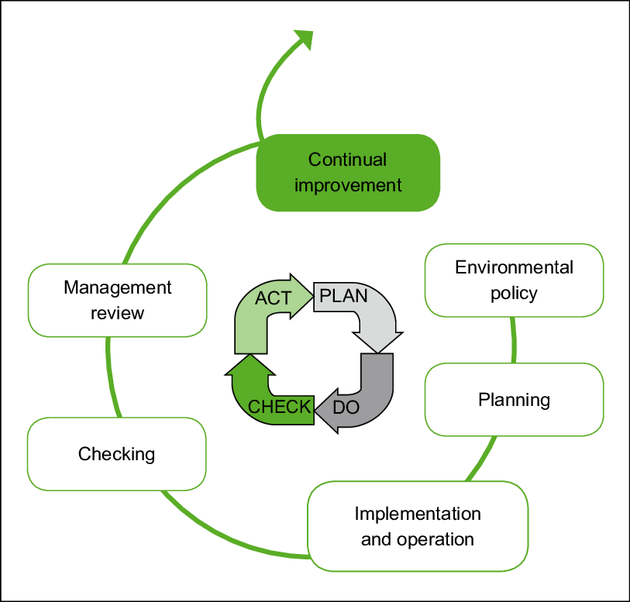
Environmental management system (EMS)
Environmental management system (EMS) is a framework that involves processes for training, implementation, evaluation, review and improvement of environmental policy and performance to enable organizations meet their environmental goals (EPA, No date).
EMS is aimed at reducing environmental waste and increasing compliance (Sayre, 1996).
EMS thrives on the Plan, Do, Check and Act (PDCA) model.
The commonly known EMS are ISO 1400, ISO 14005:2019 and Eco-management and audit scheme (EMAS)
Figure 1: Environmental management system (PDCA model) (Pelliccia et al., 2011)

Slide 3
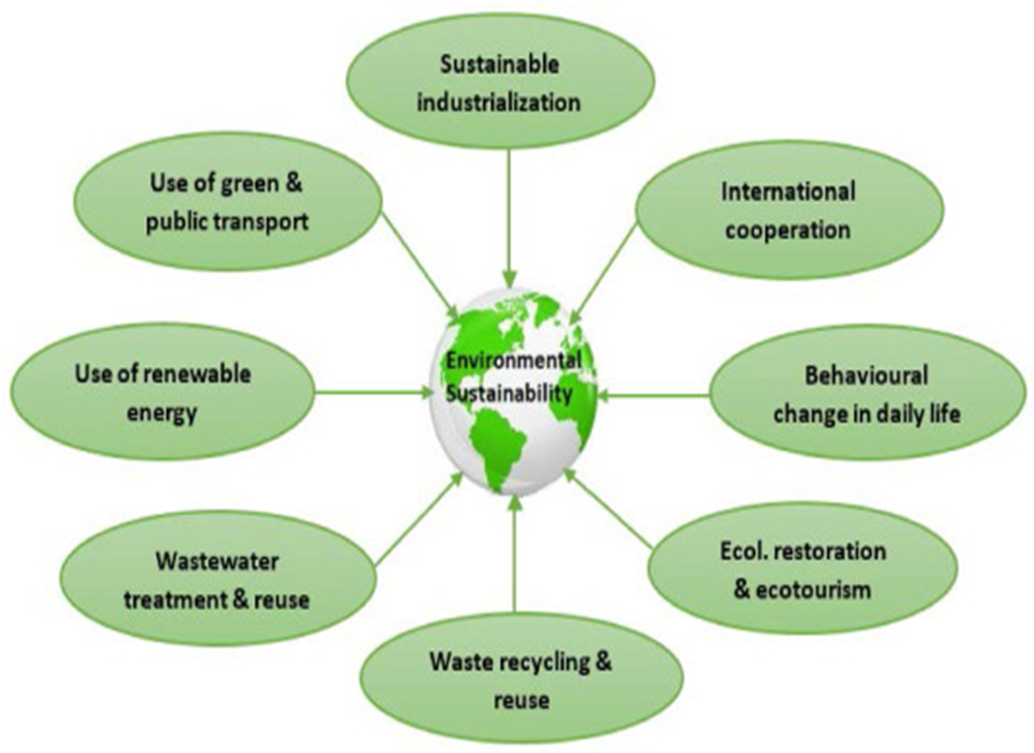
Concept of EMS
EMS is based on having an improved environment which is an aspect of sustainability.
Sustainability simply means to exist for a long time. It involves the ability of the present to meet their need with depletion to enable future generations meet theirs (WCED, 1987).
To achieve sustainability, it is necessary to evaluate ad review practices for improvement.
On this basis was the development of EMS for a sustainable environment, an approach to enable organizations meet their environmental goals.
Figure 2: Environmental sustainability (Tanjena and Didar-Ul Islam, 2020)

Slide 4
Importance of sustainability to organizations
Reduction in production costs
Brand strengthening
Enhancing the value of products and services
Improves competitive advantage
Conservation of natural resources
Improvement in employee and stakeholder confidence
The importance of sustainability is a crucial subject which all organizations should embrace despite its challenges.
We are faced with several environmental crisis such as; green house gas emissions, extreme weather conditions, terrestrial and under water biodiversity loss and environmental inequalities due to human activities.
Figure 3: Importance of sustainability to organizations

Slide 5
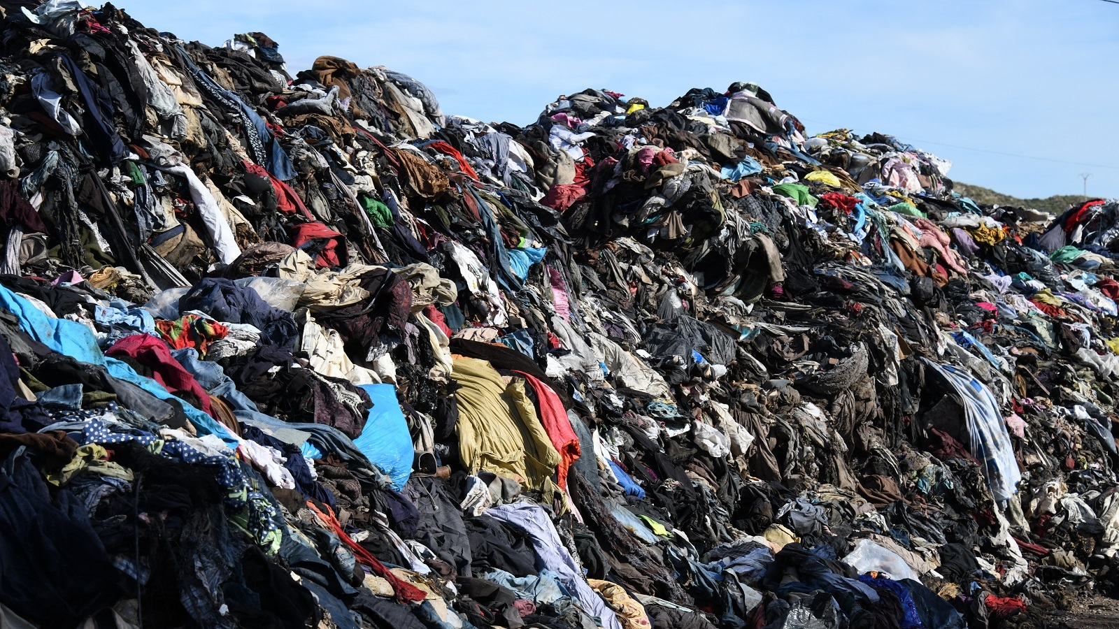
Sustainability in Fashion retail and EMS Adoption
Due to the ever increasing population, the demand for clothing is on the rise leading to increased risk of environmental crisis (Strähle and Müller, 2017).
It was estimated that about £140 million worth of clothing goes into landfill yearly in the UK (Wrap, 2015) and the fashion industry contributes about 10% of the global carbon emission (Valentina, 2021).
Fashion retailers like Marks and Spencer, GAP Inc., Target, Walmart stores among others have adopted sustainable practices (Fibre2Fashion, 2022).
Figure 4: Discarded clothes at a Landfill (Valentina, 2021)

Slide 6
EMS (Adoption of environmental policy)
Environmental management such as reduction in pollution, waste, energy and natural resources
Objectives and targets
Review of the company’s environmental performance
Environmental report
Figure 5: EMS adoption and sustainability

Slide 7
EMS adoption and its benefits to fashion retail
Fashion retailers need to distinguish themselves in the growing competitive fashion industry.
This can be achieved by adopting the current sustainability measures incorporated with consumer needs and the best practices in the industry (Sustainable Brands Insights, 2012).
In a report by Walmart in 2012, about 80% of their waste to landfills were reduced, reduction in energy usage and cost was saved as result (Walmart, 2012).
BENEFITS OF EMS
Improvements in environmental performance
Environmental compliance
Reduction in pollution and waste
Improvements in operational efficiency
Conservation of resources
Improved competitiveness
Cost reduction
Improved employee morale
Improved public image
New market and customers
Figure 6: Benefits of adopting Ems in fashion retail

Slide 8
Conclusion
The fashion industry is ever growing with concerns about the impact of their activities on the environment.
Environmental management system helps organizations to achieve environmental sustainability.
By adopting EMS in fashion retail, there will be improvements in both environmental and business performances.

Slide 9
References
Fibre2Fashion. (2022) Apparel Retail Practices in terms of Sustainability, Available at: https://www.technicaltextile.net/articles/apparel-retail-practices-6358 (Accessed: 09 February 2022).
Pelliccia, F., Parisotto, M., and Miriunis, C. (2011) ‘Environmental Guidelines for Dialysis: A Practical Guide to reduce the environmental burden of dialysis.
Sayre, D., (1996) ‘Inside ISO 14001: the competitive advantage of environmental management’. St. Lucie Press, Delray,Beach, FL.
Strähle, J., and Müller, V. (2017) ‘Key Aspects of Sustainability in Fashion Retail’, Green Fashion Retail, pp. 7–26.
Sustainable Brands Insights. (2012) Available at: http://www.sustainablebrands.com/insights. (Accessed: 09 February 2022).
Tanjena, R., and Didar-Ul Islam, S.M. (2020) ‘Environmental effects of COVID-19 pandemic and potential strategies of sustainability’, Heliyon, 6(9) e04965, ISSN 2405-8440.

Slide 10
United States Environmental Protection Agency. (No date) ‘Learn About Environmental Management Systems’, Available at: https://www.epa.gov/ems/learn-about-environmental-management-systems (Accessed: 09 February 2022).
Valentina, P. (2021) ‘The Fashion Industry Waste Is Drastically Contributing To Climate Change’, Available at: https://calpirg.org/blogs/blog/cap/fashion-industry-waste-drastically-contributing-climate-change (Accessed on 17 February 2022).
Walmart. (2012) ‘Walmart Announces Significant Progress Toward Ambitious Sustainability Goals in 2012 Global Responsibility Report’, Available at: https://corporate.walmart.com/newsroom/2012/04/16/walmart-announces-significant-progress-toward-ambitious-sustainability-goals-in-2012-global-responsibility-report (Accessed on 17 February 2022).
World Commission on Environment and Development’s (WCED) report. (1987) “Our Common Future”, UN Documents. N.d. Web. Available at: http://www.un-documents.net/ocf-02.htm (Accessed: 09 February 2022).
Wrap. (2015) ‘Clothing’ , Available at: https://wrap.org.uk/resources/guide/textiles/clothing (Accessed on 17 February 2022).

